Slide 1
Wander Lust: A Personalized Travel Planning And Tracking APP
Submitted by:
Mariya Resoba S
Manoj M
Kirubaharan R
Koorinivash N

Slide 2
Description
A project built using the Android Compose UI toolkit. It demonstrates how to create a simple travel app using the Compose libraries. It also features a personalized feed of recommended accommodations based on the locations.

Slide 3
Required Depedencies
1. Core Back-End Dependencies
Node.js (Runtime): Node.js provides the runtime environment.
Express.js (Framework): express – Web framework for routing, middleware, and API development.
MongoDB or PostgreSQL (Database):
For MongoDB: mongoose (MongoDB ODM for schema management and data handling).
For PostgreSQL: pg (PostgreSQL client for Node.js) or Sequelize (ORM for SQL databases).
GraphQL (Optional): graphql – If you prefer a GraphQL API for data management.
REST APIs: For connecting with third-party travel and map services (like Google Maps, OpenWeatherMap, or others).
Authentication: passport or jsonwebtoken – For managing user login and session security.
2. Front-End Dependencies
React (UI Framework): react and react-dom – Popular choice for building a responsive, component-based UI.
Redux or Context API (State Management): redux and react-redux for centralized state management.
React Router (Routing): react-router-dom – To handle route changes for different app pages.
Material-UI or Bootstrap (UI Components): @material-ui/core or bootstrap for pre-styled components and design.
Axios (HTTP Requests): axios for making API requests to back end and third-party services.

Slide 4
3. Location Services and Mapping APIs
Google Maps API or Mapbox: For interactive maps, location search, and geocoding.
OpenWeatherMap API or similar: For retrieving current weather data relevant to travel destinations.
4. Additional Libraries and Utilities
Lodash: lodash – Utility functions for data manipulation.
Moment.js or Day.js: moment or dayjs – For handling dates and times, such as trip schedules and duration calculations.
Formik and Yup: For form management and validation (useful for user input like destination searches, travel preferences, etc.).
5. Notifications and Analytics
Firebase or OneSignal: For sending push notifications related to travel itineraries and updates.
Google Analytics or Mixpanel: To gather user data, monitor app usage, and understand user behavior.
6. Testing & Development Dependencies
Jest and React Testing Library: For unit testing in the front end.
Mocha and Chai: For back-end testing if you’re not using Jest.
ESLint and Prettier: For code linting and formatting.
Nodemon: For automatically restarting the server in development.
7. Deployment and Environment Management
Docker: To containerize the app for easier deployment.
PM2: For process management in production.
dotenv: For managing environment variables.

Slide 5
Program Code:
<?xml version="1.0" encoding="utf-8"?> <manifest xmlns:android="http://schemas.android.com/apk/res/android" xmlns:tools="http://schemas.android.com/tools"> <application android:allowBackup="true" android:dataExtractionRules="@xml/data_extraction_rules" android:fullBackupContent="@xml/backup_rules" android:icon="@mipmap/ic_launcher" android:label="@string/app_name" android:supportsRtl="true" android:theme="@style/Theme.TravelApp" tools:targetApi="31"> <activity android:name=".RegisterActivity" android:exported="false" android:label="RegisterActivity" android:theme="@style/Theme.TravelApp" /> <activity android:name=".SingaporeActivity"

Slide 6
android:exported="false" android:label="@string/title_activity_singapore" android:theme="@style/Theme.TravelApp" /> <activity android:name=".ParisActivity" android:exported="false" android:label="@string/title_activity_paris" android:theme="@style/Theme.TravelApp" /> <activity android:name=".BaliActivity" android:exported="false" android:label="@string/title_activity_bali" android:theme="@style/Theme.TravelApp" /> <activity android:name=".MainActivity" android:exported="true" android:label="@string/app_name"

Slide 7
android:theme="@style/Theme.TravelApp"/> <activity android:name=".LoginActivity" android:exported="true" android:label="@string/app_name" android:theme="@style/Theme.TravelApp"> <intent-filter> <action android:name="android.intent.action.MAIN" /> <category android:name="android.intent.category.LAUNCHER" /> </intent-filter> </activity> </application> </manifest>

Slide 8
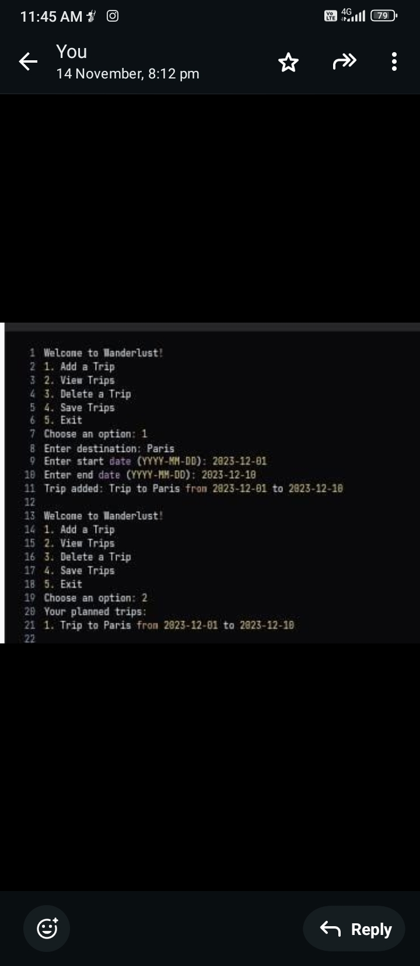
Output:

Slide 9
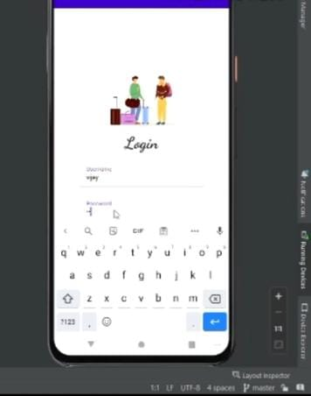

Slide 10
